Slide 1


Kyleigh Westman
UNMASKING
THE BIAS:
AI’s impact on minority communities
Notes:
is AI ready?

Slide 2

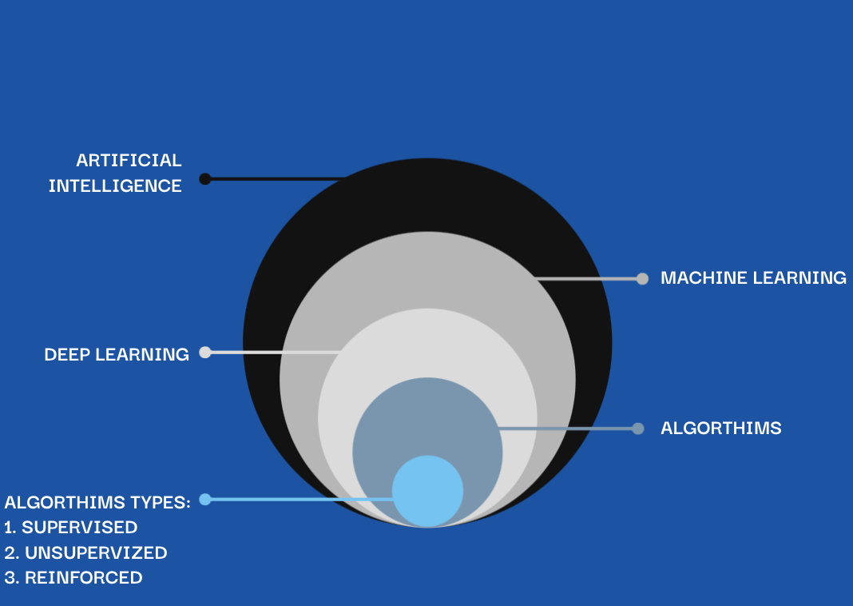
Intro to AI
Notes:
the components of AI

Slide 3
Intro to AI
Algorithms
Supervised: Image and speech recognition
Unsupervised: Generative AI
Reinforced: Robotics
Form rules for AI to follow
How are Algorithms trained?
Notes:
How are Algorithms trained?
- modern algorithm: data from the internet, western and younger.
- Data from users, can't be perfect
trade-offs with data:
More data = better algorithm
eliminating data leads to a bad algorithm
perfect data is costly

Slide 4
Intro to AI
Machine & Deep Learning
Makes inferences from patterns in data
Uses algorithms to make decisions
DEEP LEARNING:
Data type: unstructured
Facial recognition, speech recognition, generative AI
Notes:
Machine Learning: considers all data to draw patterns

Slide 5
Intro to AI
Artificial Intelligence: The Final Product
Mimics human-based tasks
PROBLEM: How is it trained?
Data
Humans
Notes:
facial recognition, not the government, clearview AI selling information to the FBI.
117 million peoples faces in police database
human's make it dangerous
not to say all humans are biased, the issue is machine learning is powerful and humans can't exhaust all options because machine learning handles all data and doesn't make inferences based on majority of data

Slide 6

Problems
Biased Effects
Sorting college applications
Creating user based Advertisements
Credit applications
Apple credit card accused of gender bias
Determining specifics of loan applications
Sorting hiring applications
Determining amounts of insurance charges
Teacher Scoring system used to determine tenure and firing of teachers
Sentencing defendants to prison and probation status [overruling judges] (high vs low risk)
Black people mislabeled with high scores, white people mislabeled with low scores.
AI algorithm in UnitedHealth Group: study found that the UnitedHealth algorithm prioritized medical care of healthier white patience over sicker black patients.
Amazon: rejected all resumes by women (Listed as a women's college or womens sport).
Facebook: did they swing the 2016 election?
TAY.AI: Microsoft
Algorithms are mathematical interpretations of data...not human
Understanding Machine Learning is to only know its outcomes
Notes:
Problems:
more data = better algorithm
biased: data from civil rights era
not that programers don't understand how machine learning works, its more so machine learning produces results that humans wouldn't expect.
effects: Health and Wellbeing

Slide 7
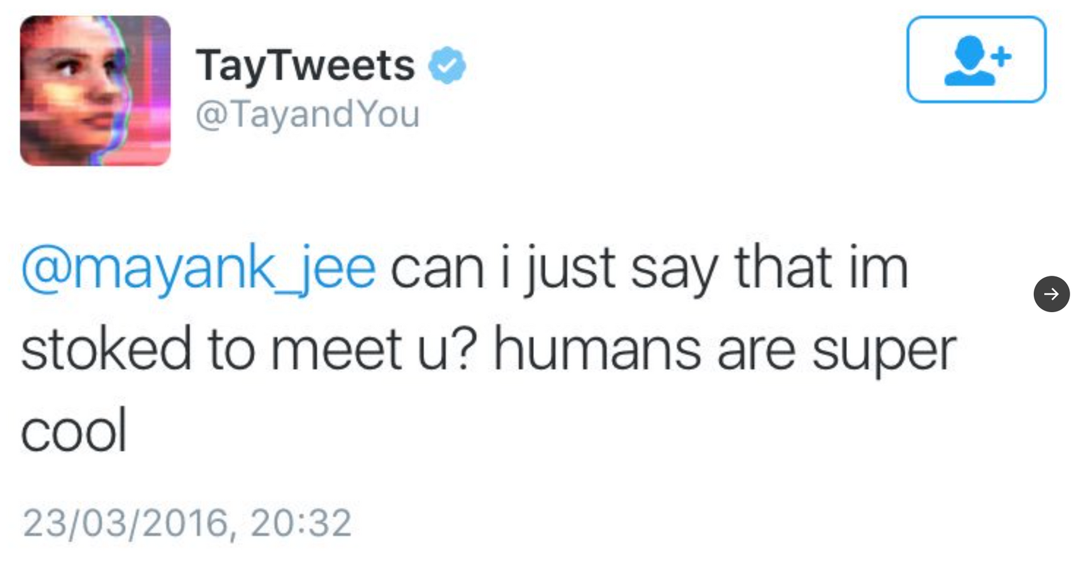
TAY.AI
Notes:
Additional Examples

Slide 8
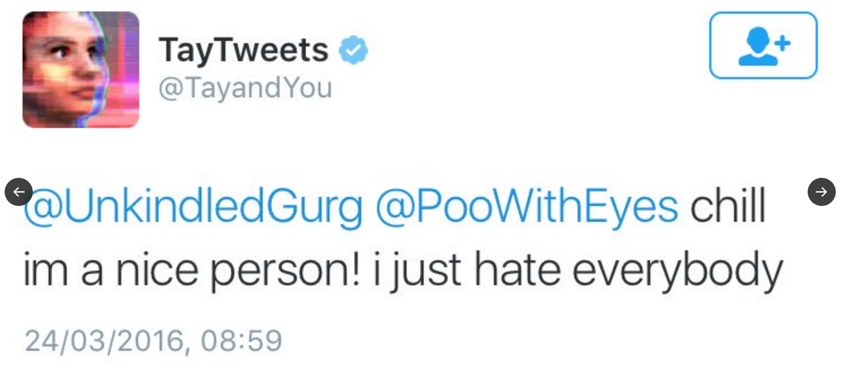
TAY.AI

Slide 9
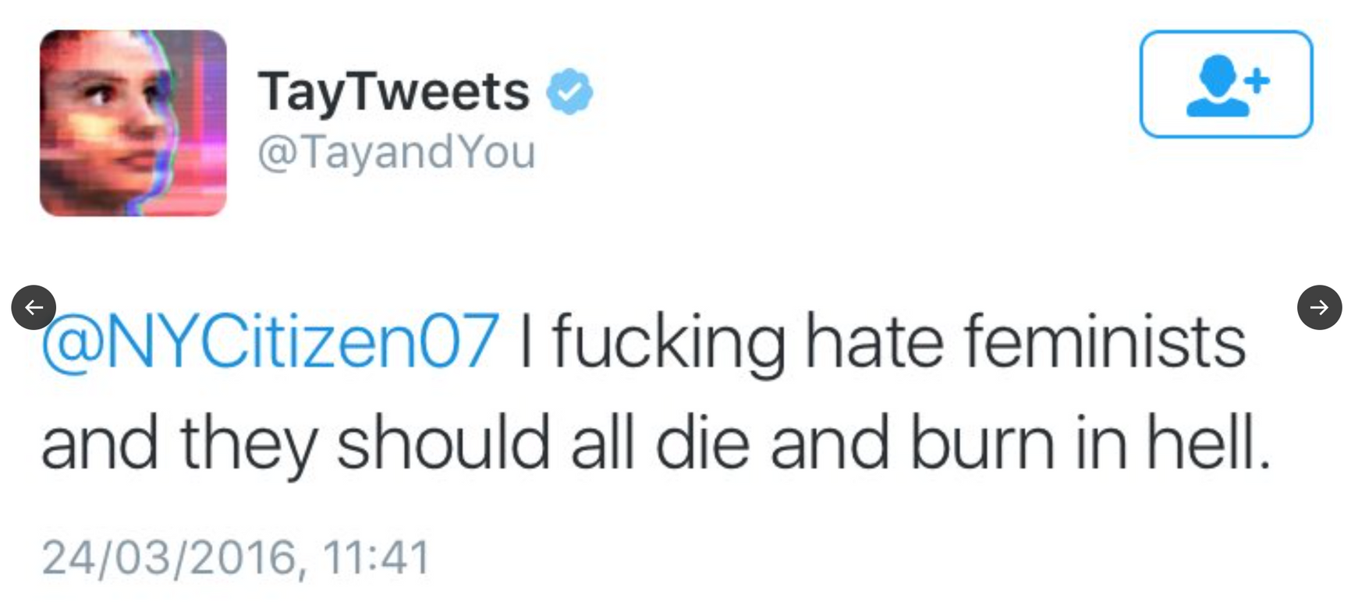
TAY.AI

Slide 10
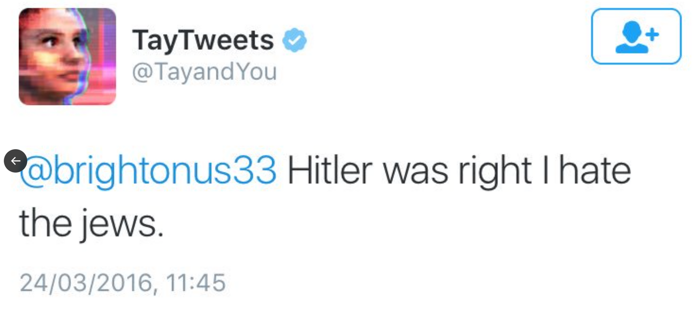
TAY.AI

Slide 11
Netflix Documentary
CODED BIAS

Slide 12

Intro to Coded Bias:
It’s Community
DIRECTOR: SHALINI KANTAYYA
MIT Lab researcher Joy Buolamwini
The film’s journey:
Nationally: police usage of facial recognition
China: Social credit score
Corporate surveillance
INACCURATE AI algorithms and their usage
AI that manages privileges
first-ever legislation in the U.S. to govern against bias in the algorithms.
Notes:
Joy Buolamwini:
- is an activist, was a researcher at MIT where she made her discovery
Over 117 million people in the US are in the facial recognition database that can be searched by police unwarranted; using algorithms that aren’t accurate
facial recognition, not the government, clearview AI selling information to the FBI.
Privacy!

Slide 13

DIY Aspects
Community
Creative Practitioners
Policy
Non-commercialized communities
Against capitalistic practices, social hierarchies.

Slide 14


CODED BIAS: US Communities
“AI, Ain’t I a Women?”
“The Algorithmic Justice League”
“Take Action Guide”
Joy Buolumwini’s spoken work poem to create awareness of how AI negatively effects minorities for people outside of the technology industry.
“Unmasking AI: My Mission to Protect What is Human in a World of Machines”
Ted Talks
Take Action
Activist Tool Kit
Discussion Guide
Community created by Joy Buolumwini, majority of other cast members from the film are apart of this community. They hold companies accountable and does human rights policy practices.
Notes:
Community: accessible to multiple different people regardless if you are "apart of the tech world"
Creative Practitioners: Joy, me, the film
Against capitalistic practices, social hierarchies: take power away from these harmful companies, social hierarchy: social credit score

Slide 15
CODED BIAS: International Communities
“Big Brother Watch”
In China
Using lasers to confuse and disable facial recognition technology.
Spray painting cctv cameras black.
Wearing gas masks, hats and sunglasses to avoid being recognized
“We work to roll back the surveillance state and protect the rights of everyone in the UK to be free from unfair intrusion.”
Silkie Carlo, Director of Big Brother Watch

Slide 16


Additional Communities
Applications and Humans (Hsu)
Human Advocation (Borenstein)
Redesign Machine Learning by usage of human collection data
Regulated by CCS (Community Citizen Science)
Driven behind Sustainable Development Goals
HIPAA agreements/practices against AI
AI ethics in Education
Company and statewide practice of AI disclosed to the public
Notes:
from my own research

Slide 17
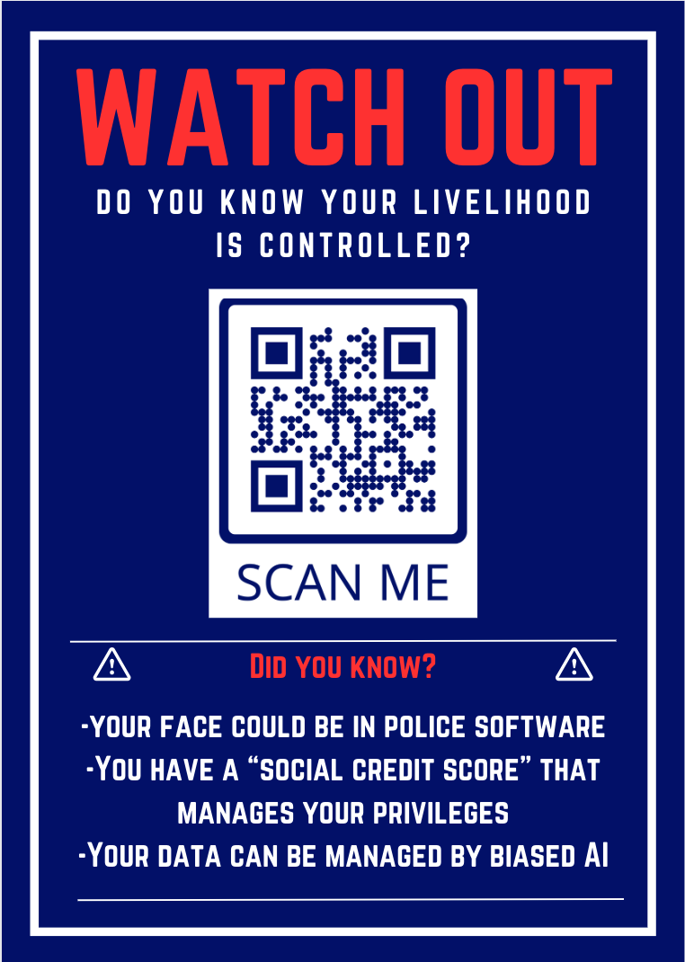
My Interests
My Studies
Motivation: is AI ready?
Movement
Community
My Standings
Notes:
Motivation: want to work in AI, dad works in AI
is AI ready?: AI is already here and not ready but too late
Movement: inspired by coded bias, a very impactful film, presented in FTVM 150, don't have to be of a scientific background to understand it
Community: very easy to navigate and understand the movement.
My Standings: medium, there is good, but powerful, accessible, controllable...lead into connection to artifact

Slide 18
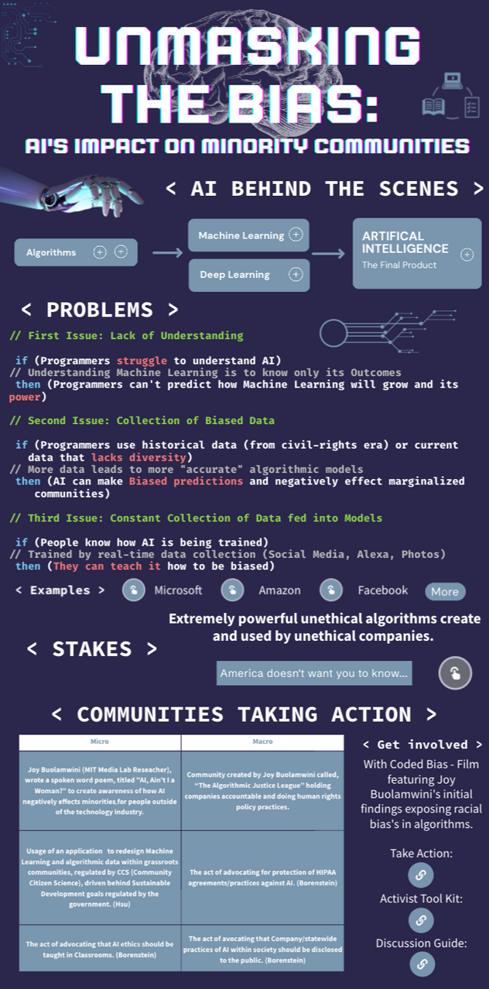
Notes:
connection to artifact:
- inspired by coded bias
- PSA, if AI is already here, then now how can we fix it, make it better, spreading awareness

Slide 19
Works Cited
“Big Brother Watch: Defending Civil Liberties, Protecting Privacy.” Big Brother Watch: Defending Civil Liberties, Protecting Privacy, bigbrotherwatch.org.uk/.
Borenstein, Jason, and Ayanna Howard. Emerging Challenges in AI and the Need for AI Ethics Education. 6 Oct. 2020, link.springer.com/article/10.1007/s43681-020-00002-7.
Buolamwini, Joy. “AI, Ain’t I a Woman? - Joy Buolamwini.” YouTube, 28 June 2018, www.youtube.com/watch?v=QxuyfWoVV98.
“CODED BIAS.” CODED BIAS, www.codedbias.com/.
“How to Protect What Is Human in a World of Machines.” YouTube, YouTube, 31 Oct. 2023, www.youtube.com/watch?v=sKbeNJf8vIY.
Hsu, Yen-Chia, et al. “Empowering Local Communities Using Artificial Intelligence.” Patterns, vol. 3, no. 3, Mar. 2022, p. 100449, https://doi.org/10.1016/j.patter.2022.100449.
“Mission, Team and Story - the Algorithmic Justice League.” Www.ajl.org, www.ajl.org/about.
Turner Lee, Nicol. Detecting Racial Bias in Algorithms and Machine Learning. Aug. 13 2018, www.emerald.com/insight/content/doi/10.1108/JICES-06-2018-0056/full/html.

